Slide 1

MODULE III
RULES OF ORIGIN
Presented By:
LRA TRAINING TEAM

Slide 2

OUTLINE
1. Objectives
2. Introduction
3. The legal basis for Rules of Origin
4. Scope of Rules of Origin
5. Proof of Origin
6. Principles for Rules of Origin
7. Origin conferring criteria
8. What is Wholly obtain?
9. Substantial Transformation criterion
What is Minimum Operations?
What De Minimis?
4

Slide 3
OBJECTIVES
At the end of this module, the participants will be able to:
Discus the legal framework of RO
Discuss Rules of Origin with emphasis to Preferential
and Non- Preferential rules of origin
Discus the origin conferring criteria
Explain the purpose of ECOWAS’ origin certificate
4

Slide 4
INTRODUCTION
Rules of Origin (RO) are the means by which we determine where goods originate, i.e. not where they have been shipped from, but where they are deemed to have been produced or manufactured.
1

Slide 5
INTRODUCTION cont.
The participants in this course are entreated to do their
utmost best to enhance their knowledge and skills to make
them efficient and active participants and to contribute
effectively to the conduct of the class session. This may lead
to a successful pass in the Customs Brokers Licensing
uniform examination.
2

Slide 6
INTRODUCTION cont.
On the other hand, participants who may not assert
themselves proficiently in this module, could stand the risk
of not passing the uniform examination and may fail to be
licensed to practice as professional Customs broker.
3

Slide 7
WHAT IS THE LEGAL BASIS OF RO?
Articles I, II, III and XI of GATT 1994 (MFN)
Article VI of GATT 1994 (adcd)
Article XIX of GATT 1994 (sgm)
Article IX of GATT 1994 & Annex II
Accession to WTO
Ratification of ECOWAS’ ETLS protocol, 2003
ACP, AGOA agreements, etc.
5

Slide 8
CATEGORIES OF RO
Rules of Origin
Preferential Rules
Non-Preferential Rules
6

Slide 9
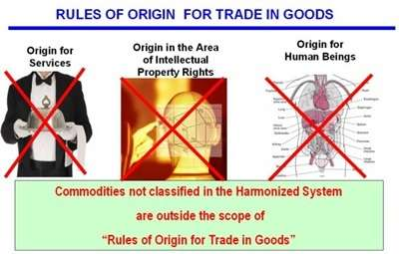
WHAT RULES OF ORIGIN DOES NOT COVER?
7

Slide 10
WHAT RULES OF ORIGIN DOES NOT COVER? CONT.
FREEZONE GOODS UNDRER ETLS
Goods transformed within the framework of economic or suspense
Customs regimes or certain special regimes involving the suspension,
or partial or total exemption from Customs duties on inputs, shall in
no case be considered as originating products.

Slide 11
PROOF OF ORIGIN
A Certificate of Origin (CO), issued by designated, authority
in the country of export (Member State)
Statement of declaration issued by the exporter or manufacturer
8

Slide 12
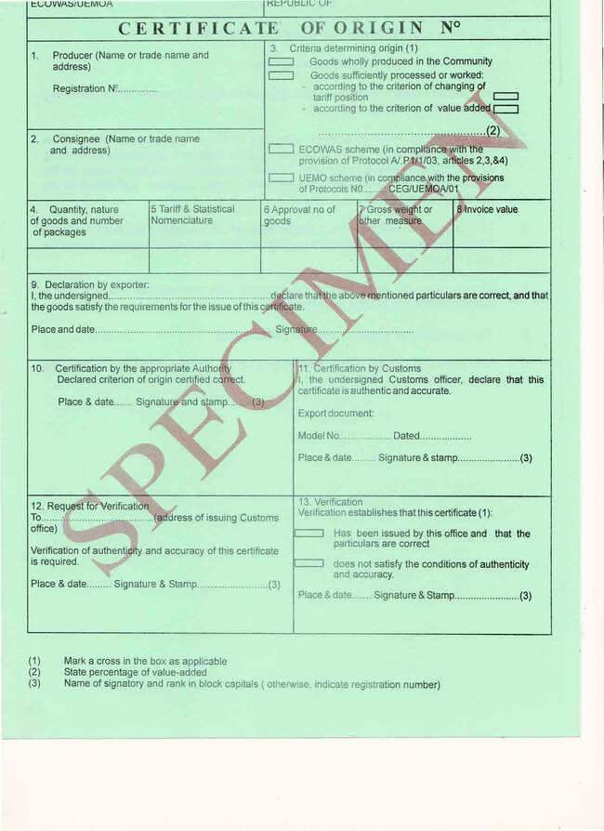
ECOWAS’ CERTIFICATE OF ORIGIN (SAMPLE)
10

Slide 13
PRINCIPLES FOR PROOF OF ORIGIN
Principle 1: Simplicity
-The rules must be cleared and transparent in order
to minimize the possibility of being applied in
subjective, biased, or fraudulent manner. Else, they create
needless hitches that hinder trade.
9

Slide 14
PRINCIPLES FOR PROOF OF ORIGIN cont.
Principle 2: Predictability
-The rules must be amply clear, recognized and
stable to enable the manufacturer to predict in a
clear and secure manner how the rules will be applied
to various goods, taking into account their
respective destinations.
9

Slide 15
NO CO REQUIREMENT IMPORTS
Certificate of Origin shall not be required for
agricultural and livestock products, hand-made
articles or articles produced with or without the use of
tools, instruments or implements directly operated by
the craftsman.
Example:
Cows, goats, carved wood, plantains, chickens, etc.
9

Slide 16
WHAT IS PREFERENTIAL RO?
Simply means, trade agreements between
governments that allow goods of their countries to
be imported at reduced or zero duty rates.
Example:
Manu River Union Protocol (Guinea, Ivory Coast, Liberia & Sierra
Leone )
11

Slide 17
WHY USED PREFERENTIAL RO?
It is used for the following:
1. Generalize System of Preferences (GSP);
2. Free Trade Agreement (FTA);
3. Regional Trade Agreement (RTA).
Example:
ACP Agreement (EU and African countries, +)
12

Slide 18
WHY USE PREFERENTIAL RO? Cont.
Examples:
1. ACP Agreement with EU and African countries
2. ETLS Protocol (ECOWAS members states)
3. Manu River Union Protocol (Guinea, Ivory Coast, Liberia &
S/Leone )
4. AGOA Protocol/Agreement (between America and
African countries, +).

Slide 19
WHAT IS NON-PREFERENTIAL RO?
Article 1 of GATT 1994 defines it as those laws, regulations and
administrative determinations of general application applied to
determine the country of origin of goods except those related to the
granting of tariff preferences.
Example: Most-Favor-Nation treatment (MFN)

Slide 20
WHY USE NON-PREFERENTIAL RO?
They are used for commercial policy measures as:
1. Anti-dumping and Countervailing duties; MFN;
2. Trade embargoes, Safeguard and retaliation measures;
3. Quantity restrictions and tariff quotas;
4. Trade statistics and Public tender; etc.

Slide 21
ORIGIN CONFERRING CRITERIA
They are 2 criteria that confer origin on trade in goods:
1. Wholly obtained criterion
2. Substantial/sufficient transformation criterion

Slide 22
WHAT IS WHOLLY OBTAINED?
Trade in goods considered wholly obtained includes:
1. live animals born and raised within the Member States;
2. mineral products extracted from the ground, sub-soil or sea bed
of Member States;
3. vegetable products harvested within Member States;
4. products obtained from animals living or raised in Member States;

Slide 23
WHAT IS WHOLLY OBTAINED? Cont.
5. products obtained by hunting or fishing within member States;
6. products obtained from the sea, river and lakes within Member
States by vessels belonging to the Member States;
7. products manufactured aboard ship factories belonging to member
States exclusively from products referred to in paragraph (6) above;

Slide 24
WHAT IS WHOLLY OBTAINED? Cont.
8. used articles fit only for the recovery of raw materials, provided
that such articles have been collected from users within member States;
9. scraps and waste resulting from manufacturing operations within
Member States;

Slide 25
WHAT IS WHOLLY OBTAINED? Cont.
10. goods produced from the materials listed in paragraphs 2 to 9
above, used alone or mixed with other materials, provided that
they represent at least 60% of total quantity of raw materials used;
and
11. electrical energy produced in the Member States;

Slide 26

EXAMPLES OF WHOLLY OBTAINED
1. Live animals born and raised in the country

Slide 27
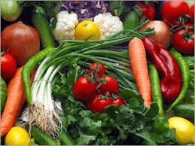
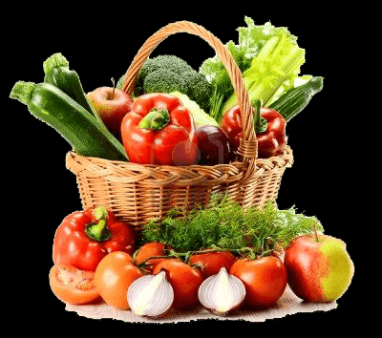
EXAMPLES OF WHOLLY OBTAINED Cont.
2. Vegetable products and harvested in the country

Slide 28
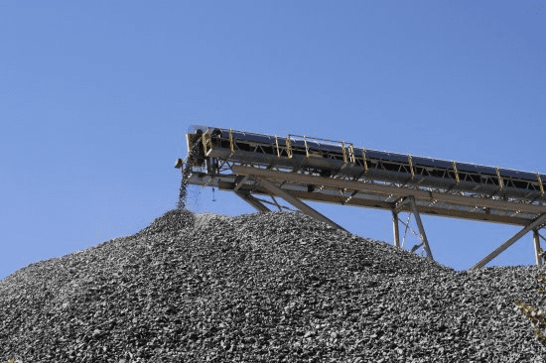

EXAMPLES OF WHOLLY OBTAINED Cont.
3. Mineral Products extracted within the country
Diamond
Iron Ore

Slide 29
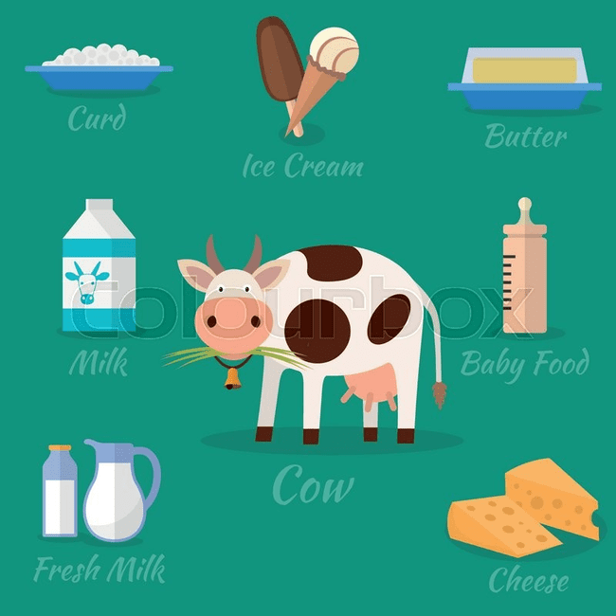
EXAMPLES OF WHOLLY OBTAINED Cont.
4. Products derived from live animals raised in the country

Slide 30
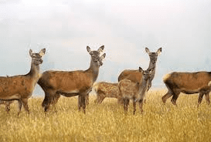

EXAMPLES OF WHOLLY OBTAINED Cont.
5. Products of hunting or fishing in the country

Slide 31
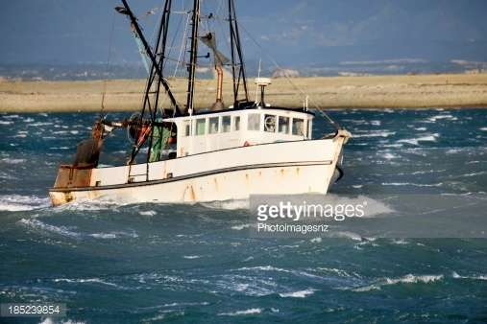
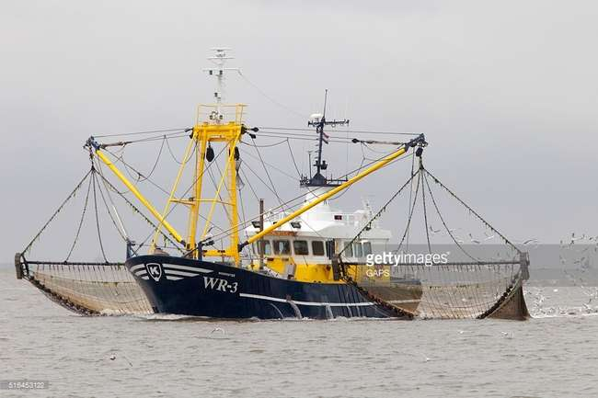
EXAMPLES OF WHOLLY OBTAINED Cont.
6. Products of sea fishing and other products taken from the sea by its vessels

Slide 32
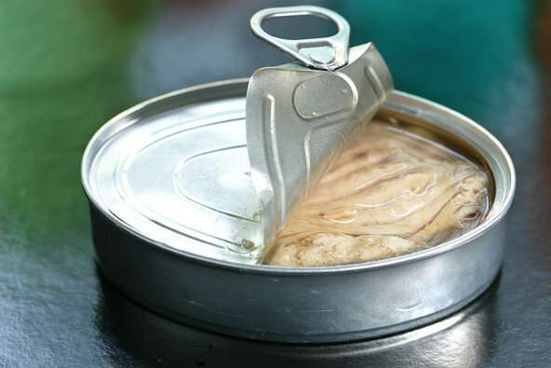

EXAMPLES OF WHOLLY OBTAINED Cont.
7. Products made on board its factory ships exclusively from the products in (6)

Slide 33
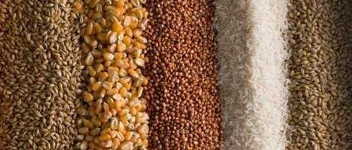
EXAMPLES OF WHOLLY OBTAINED Cont.
8. Used articles collected there fit only for the recovery of raw materials

Slide 34
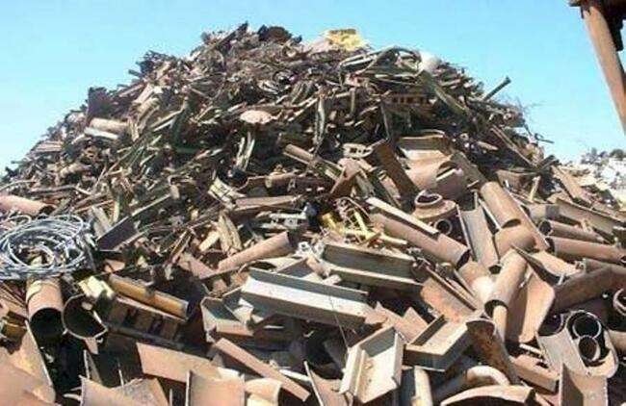
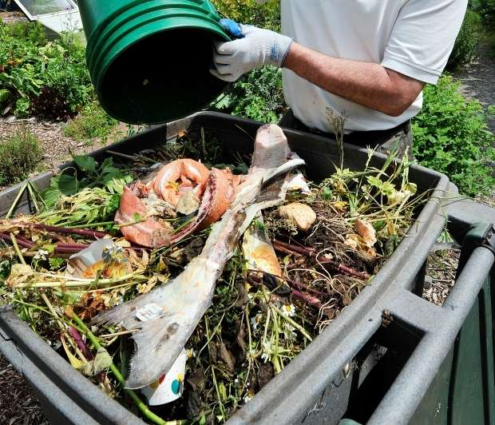
EXAMPLES OF WHOLLY OBTAINED Cont.
9. Waste and scraps resulting from manufacturing operations conducted there

Slide 35
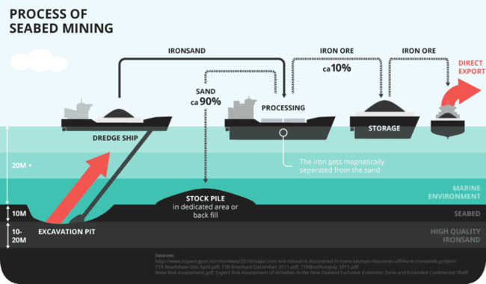
EXAMPLES OF WHOLLY OBTAINED Cont.
10. Products extracted from the sea bed or below the sea bed which is situated
outside its territorial waters, provided that it has exclusive exploitation

Slide 36
EXAMPLES OF WHOLLY OBTAINED Cont.
10. Products produced goods exclusively from originating
products specified in (1-10)
11. Electrical energy produced in the Member States

Slide 37
WP’S FARMULA.
Goods are regarded as WHOLLY PRODUCED within ECOWAS,
if at least 60% of the total quantity of raw materials used
originate from the ECOWAS region quantity of raw materials
used originate from the ECOWAS region
WP= ECOWAS RM/(ECOWAS RM + FOREIGN RM) in %
Where
ECOWAS RM: Quantity of raw materials originated from ECOWAS
FOREIGN RM: Quantity of raw materials originated from Foreign
=WP > 60%

Slide 38
SUBSTANTIAL TRANSFORMATION CRITERION
There are 3 major criteria:
1. Change of Tariff Classification criterion
2. Value Added (ad valorem percentage) criterion
3. Manufacture or Processing operations (technical
requirement) criterion.

Slide 39

SUBSTANTIAL TRANSFORMATION CRITERION cont.
What is sufficient working or processing?
Products which incorporate materials NOT WHOLLY OBTAINED but which have undergone SUFFICIENT TRANSFORMATION OR PROCESSING.

Slide 40
WHAT IS CHANGE OF TARIFF CLASSIFICATION?
Good is considered substantially transformed when it is classified in
heading or subheading (depending on the exact rule) different from all
non originating materials used.
Example:
2523.10 = Cement clinkers CHT
2523.29 = Portland cement

Slide 41
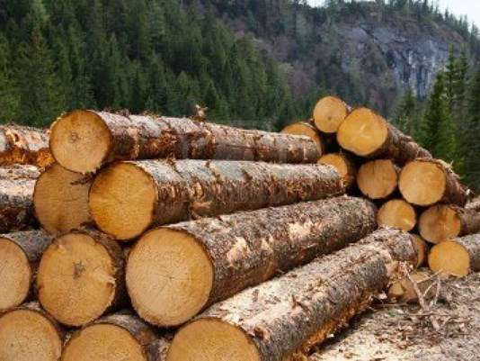


CHANGE OF TARIFF HEADING CRITERION (CTC)
Wood in the rough 44.03
Cut in Country A
Made to furniture tables 94.03 in country Y
Country A
Wood sawn & planed 44.07
In county R
Country R
Imported into country Z
Are the goods originate in country y? YES

Slide 42
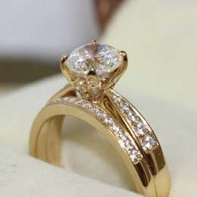
CHANGE OF TARIFF HEADING CRITERION (CTC) Cont.
Jewelry
71.13
Diamond
21.02
Diamond
Does this qualify as originating?
Gold
Gold
71.08
YES

Slide 43
CTC’S FORMULA
No special formula
Tariff heading of final product is different from constituent
materials
Worked beyond minimal operations
Sometimes, eyes test.

Slide 44
HOW DOES VALUE ADDED WORKS?
Regardless of change in classification, good is considered transformed
substantially when:
1. value added > 30% (ex-works) for ETLS purpose
VA can be expressed in 2 ways as:
i. maximum allowance for non originating materials
ii. minimum requirement of domestic content.

Slide 45
VA’S FORMULA
- Value Added:
VA = [(Ex-factory CP) – CIF value FOREIGN RM – CIF value FOREIGN CONSU – CIF value FOREIGN PACK] / (Ex-factory CP) in %
-VA > 30%
Requirements to be fulfilled:
Salaries and wages may not exceed 20% of Cost price
Works, supplies and external services may not exceed 10% of Cost
price, and must be directly tied to production
Financial charges may not exceed 3% of Cost price

Slide 46
HOW DOES VALUE ADDED WORKS? Cont.
Example:
8529, parts suitable for use solely or principally with the apparatus of headings numbers 8525 to 8528.
45% value added

Slide 47
VALUE ADDED CRITERION
Solve the problem below. Time: 2 minutes
The minimum limit of originating value is 30%. Find The % of value added for the product below and determine if they originate Or not.
Product A Product B
Labor 20% Labor 12.5%
Electricity 15 Electricity 10%
overhead 10 Overhead 4%
Profit 10 Profit 2.5%
Total % Total %

Slide 48
MANUFACTURING OR PROCESSING OPERATIONS
Regardless a change in classification, a good is
considered substantially transformed when the good
has undergone specified manufacturing or processing
operations.
Example: (basic rule) All ingredients change heading
Water 22.01 no restriction on their origin
Malt 11.07 beer originates in country of production
Hops 2.10
Sugar syrup 17.02 Beer 22.03

Slide 49
WHAT IS MINIMAL OPERATIONS?
Reverse form of Manufacturing operations
Seen in Preferential and Non-preferential Agreements
Points to operations that are insufficient and do not confers origin
Examples:
1. labeling 2. Packaging 3. Assembling

Slide 50
MINIMAL OPERATIONS, NO ORIGIN CONFERED
1. Operations for preservation of products during transport and storage:
chilling
placing in salt, sulphur dioxide, or other aqueous solutions
removal of damaged parts, etc.

Slide 51
MINIMAL OPERATIONS, NO ORIGIN CONFERED cont.
2. Simple operations such as:
• Removal of dust, sifting or screening, sorting, washing, painting, cutting
up, and matching including the making up sets of articles;
3. Changing or packing and breaking up and assembly of consignments
• placing in bottles, flasks, bags, boxes
• fixing on cards, boards, and other simple packaging operations

Slide 52
MINIMAL OPERATIONS, NO ORIGIN CONFERED cont.
4. Affixing marks, labels or other distinguishing signs on products or
on their packaging
5. Simple mixing of products, whether or not of different kinds, where
one or more of the component mixtures do not meet the conditions laid
down in the rules to enable them to be considered originating products

Slide 53
MINIMAL OPERATIONS, NO ORIGIN CONFERED cont.
6. Simple assembly of parts of products to constitute a complete
product
7. Simple combination of two or more operations shown in 1 to 6
8. Slaughter of animals does not qualify as ‘sufficient
transformation’

Slide 54
DE MIMIMIS OR TOLERANCE RULE
Permits a specific share (often between 10% & 15%) of value or volume
of final product to be non originating
Final product maintains originating status
Applicable components identified in Agreement
Example:
HS chapters to which the tolerance does not apply.

Slide 55
ROLLING-UP” OF PREFERENTIAL STATUS METHOD
Rolling-Up: When establishing the origin status of parts:
Calculate the local content,
Calculate the non-originating materials,
If the parts qualifies as originating, then all the non-originating
materials obtain originating status.

Slide 56
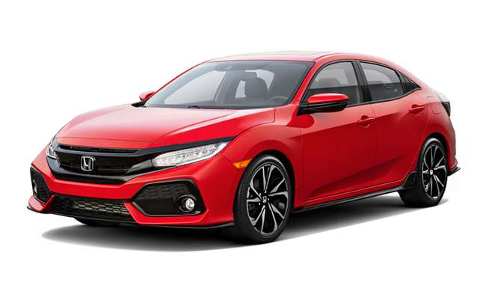
ROLLING-UP” OF PREFERENTIAL STATUS METHOD cont.
ROLLING-UP” OF PREFERENTIAL STATUS METHOD
The engine for this car has to be at least 60% originating, if it is, then
the whole car becomes originating.

Slide 57
ROLLING-UP” OF PREFERENTIAL STATUS METHOD cont.
Rolling – up benefit:
As the engine is 100% originating, then the non-originating parts it contains are not taken into account when calculating the origin status
of the car.

Slide 58
ROLLING-UP” OF PREFERENTIAL STATUS METHOD cont.
Rolling – up example:
The rule for engines of heading 8407 is: Manufacture in which the value of all he non-originating materials used does not exceed 40% of the ex-works price of the product.
Pistons $ 10
Crankshaft 08
Bearing 05
Valve assembly 10
Distributor 05
Total Value $ 38
Total value of non-originating parts = 38% of the value of engine. The engine originates and the benefit is that the 38% non-originating value of the engine is absorbed into the originating status of the car.

Slide 59
DONOR COUNTRY CONTENT
When component materials are supplied by a country, or a group of
countries such as the EU, and the finished product is to be exported
to that same supplying; then the materials supplied by the donor
country are deemed to have originated in the country of manufacture.

Slide 60
TRANSPORT CONDITIONS
What is directly consigned?
Goods transported without passing through another country – except
in the case of reginal cumulation.
Goods transshipped through another country for the purposes of consignment – provided they have remained under customs control.

Slide 61
TRANSPORT CONDITIONS cont.
Directly consigned, evidence required:
A through bill of lading issued in the exporting beneficiary country covering passage through the country of transit or;
Certification issued by customs in the country of transit detailing the goods, dates, transport, and conditions they remained in that country or;
Failing these, any substantial documents.

Slide 62
SUMMARY
In closing, we realized that RO is in short, a citizenship status of trade in goods;
We discussed RO from the perspective of its make up- Preferential and
Non-Preferential status;
Its legal basics including the proof origin and certificate of origin were sufficiently look at;
We further looked at the principles for proof of origin (simplicity and
predictability) as well as the origin conferring criteria of Wholly
obtained and Substantial/sufficient criteria;
We also, looked at what is considered value added, change of tariff
herding and minimum operations.

Slide 63
SUMMARY cont.
We also, looked at what is considered value added, change of tariff
herding and minimum operations.
Finally, we looked at De Minimis or Tolerance rules, Rolling –Up
of preferential status method and Transport conditions.

Slide 64
THANK YOU
Q &A

Slide 65
EXERCISE # 1
Problem # 1.
Determine the origin status of the products in table 1 using the Wholly Obtained criterion.
Product manufactured: Super Gari containing added sugar or other sweetening material | Reference year: 2015
Description of raw materials | ECOWAS Customs Nomenclature Number | Quantity utilised | Value on entry into factory (USD)
A. Raw materials of foreign origin
Sugar | 1701.91.10.00 | 110 tons | 327,500.00
Milk power | 0402.10.10.00 | 130 tons | 32,500.00
B. Raw materials of ECOWAS origin
Gari | 0714.10.00.00 | 850 tons | 148,750.00

Slide 66
EXERCISE # 2
Product manufactured: Praise shower Slippers (6402.99.90.00) | Reference year: 2016
Description of raw materials | ECOWAS Customs Nomenclature Number | Quantity utilised (in tons) | Value on entry into factory (USD)
A. Raw materials of foreign origin
ETHYLENE VINYL ACETATE | 3901.30.00 | 1 161 | 63,855.00
PVC RESIN | 3904.10.00 | 200 | 70,000.00
DI OCTYL PHTHALATE | 2917.32.00 | 80 | 16,800.00
B. Raw materials of ECOWAS origin
RUBBER | 4001.29.00.00 | 400 | 90,000.00
ZINC OXYDE | 2817.00.00.00 | 85 | 26,775.00
CALCIUM CARBONATE | 2836.50.00.00 | 1,400 | 210,000.00
COALIN CLAY | 2836.50.00.00 | 600 | 63,000.00
Problem # 2:
Using the opposite table,
determine whether the
product is originating in
line with change of tariff
classification (CTC).

Slide 67
NO | QUESTIONS | ANSWERS
1 | There are how many types RO
2 | Proof of Human nationality is passbook, what is the proof of trade in goods’ origin?
3 | Give any Origin criteria.
4 | What are the principles for proof of Origin?
5 | Name any 2 products suited under the wholly obtained criteria.
6 | Distinguish Preferential and Non-Preferential Rules of Origin
7 | Rules of Origin is designed to identify the citizenship of cargos | True/False
8 | RO Agreement is administered by the World Customs Organization (WCO) | True/False
9 | Animals raised in an importing country fall under sufficiently transform criteria | True/False
10 | The criteria of Value Added are for change of tariff heading. | True/False

