Slide 1

CUSTOMS BROKERS LICENSING TRAINING PROGRAM
MODULE II:
INCOTERMS & COMMERCIAL LAW
Presented By: LRA TRAINING TEAM

Slide 2

MODULE OUTLINE
Introduction
Module objectives
Session I Outline
Session I objectives
Brief History of Incoterms
Terms organization
7. What is international contract of sales?
8. Key elements of binding contract
9. Composition of Vienna Sales Convention (VSC)

Slide 3
MODULE OBJECTIVES
At the end of module, the participants will be able to:
Discuss the purpose of Incoterms
Identify the groups/structure of Incoterms
List the trade terms
Demonstrate the use of Incoterms chart
Explain the purpose of contract for international sale of goods
Explain the key elements of contract for international sale of goods
Discuss the key issues to consider in contracting

Slide 4
INTRODUCTION
This module attempts to present the rational for the
alignment of appropriate International Commercial
terms (Incoterms)in International contract laws for the
movement of cargos across borders.

Slide 5
INTRODUCTION CONT.
The participants in this course are entreated to do their
utmost best to enhance their knowledge and skills to
make them efficient and active participants and to
contribute effectively to the conduct of the class session.
This may lead to a successful pass in the Customs Brokers
Licensing uniform examination.

Slide 6
INTRODUCTION CONT.
On the other hand, participants who may not assert themselves
proficiently in this module, could stand the risk of not passing
the uniform examination and may fail to be licensed to practice
as professional Customs broker.

Slide 7
SESSION I
INTERNATIONAL COMMERCIAL TERMS
(INCOTERMS)

Slide 8
SESSION OUTLINE
Session Objectives
Introduction
Division of Incoterms
Brief history of Incoterms
Dos and Don’ts of Incoterms
The organization of Trade Terms
Incoterms Chart

Slide 9
SESSION OBJECTIVES
At the end of the session, the participants will be able to:
Discuss the formation of Incoterms
List the Incoterms
Identify the terms by groups/structure
Discuss the terms according parts
Explain the terms according to level of risk bear by each party
Demonstration the use of Incoterms chart

Slide 10
INTRODUCTION
Incoterms are series of internationally recognized standardized trade
terms published by the International Chamber of Commerce (ICC)
and widely used in international sales.
They cover issues like who does what, who pays for what and when
risk in the goods passes from seller to buyer. Also, when delivery
occurs, as well as matters such as insurance, export and import
clearance and the division of other costs pertaining to the delivery
of goods. These are determinant factors in the valuation process
of goods. Hence, brokers need to be knowledgeable of incoterms.

Slide 11
BRIEF HISTORY
ICC introduced Incoterms in 1936 & are revised every 10 years
They were 13, but now simplified to 11 terms
Incoterms comprises 3 English language letters acronym
The current version is Incoterms 2010
Exclusively used in sales/purchase contract
Updated to reflect current trade practice
Written to reflect rather than dictate trade practice
Always accompanied by a geographic place (the more precise the be
better).

Slide 12
TABULAR SUMMARY -INCOTERMS
SPECIFICATIONS | Departure from ware-house | Main transportation not paid by the seller |  |  | Main transportation paid by the seller |  |  |  | Shipping charges paid by the seller until reaching destination point
Incoterm / Cost | EXW | FCA | FAS | FOB | CIP | CIF | CPT | CIP | DAT | DAP | DDP
Packaging | S | S | S | S | S | S | S | S | S | S | S
Loading from warehouse | B | S | S | S | S | S | S | S | S | S | S
Pre-carriage | B | S | S | S | S | S | S | S | S | S | S
Export customs clearance | B | S | S | S | S | S | S | S | S | S | S
Handling at departure | B | B | B | S | S | S | S | S | S | S | S
Main transportation | B | B | B | B | S | S | S | S | S | S | S
Transportation insurance | B | B | B | B | B | S | B | S | S* | S* | S*
Handling at arrival | B | B | B | B | B | B | B | B | S | S | S
Import customs clearance | B | B | B | B | B | B | B | B | B | B | S
Post-carriage | B | B | B | B | B | B | B | B | B | B | S
Unloading into warehouse | B | B | B | B | B | B | B | B | B | B | S

Slide 13
THE DOs OF INCOTERMS
Divide costs, risks and responsibilities between sellers and buyers.
Guide one or the other party into subsidiary contracts required to
fulfill designated tasks such as contracts of carriage and contracts of
insurance.

Slide 14
THE DON’Ts OF INCOTERMS
Address passage of title.
Address recognition of revenue.
Address remedies for breach of contract.
Address more than one contract (drop shipments).
Note:
They are not law, but they must be specified in order to apply.
Not All inclusive, they cannot address such issues as customary
operations of carriers, ports, trades, government regulations, etc.

Slide 15
TERMS ORGANIZATION
Incoterms are organized into:
4 TERMS GROUPS (b4 2010)
Departure (E)
Main Carriage unpaid (C)
Main Carriage Paid (F)
Arrival (D)
3 PARTS
Part I
Part II
Part II
2 TRANSPORT MODES (2010)
1. Any Transport Mode 2. Maritime Transport Mode

Slide 16
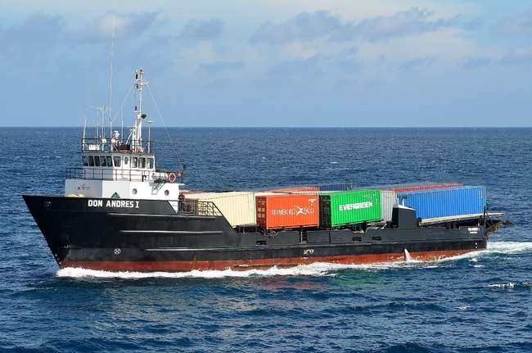
MARITIME TRANSPORT MODE
There are 4 terms in this mode as follow:
Free Alongside Ship (FAS)
Free on Board (FOB)
Cost and Freight (CRF)
Cost, Insurance and Freight (CIF)

Slide 17
RECOMMENDED FOR CONTAINERS CARGOS
FOB = FCA
CRF = CPT
CIF = CIP

Slide 18
PART I-III OF INCOTERMS
1. PART I
Comprises of D and F groups (EXW, FAS, FCA & FOB)
2. PART II
Incorporates only the C group terms (CPT, CRF, CIF & CIP)
3. PART III
incorporates only D group terms (DAT, DAP & DDP)
4 terms replaced in 2010 (DEF, DES, DDU & DEQ) only in this group

Slide 19
CHANGES IN INCOTERMS 2010
  DAT (delivered at Destination)
    - Delivered at a named place, at buyer’s disposal, unloaded
    Replaces DEQ
  DAP (delivered at place)
    - Delivered at a named place, at buyer’s disposal, not unloaded
    Replaces DAF, DES, DDU
  Guidance notes
    - Explain fundamentals, usage, risk, cost, etc.

Slide 20
CHANGES IN INCOTERMS 2010 cont.
Rules for Any Mode of Transport
  - EXW, FCA, CPT, CIP, DAT, DAP, DDP
Rules for Sea and Inland Waterway Transport
  FAS, FOB, CFR, CIF
Electronic Communication
  Electronic means of communication now given same effect as paper as long as parties agree or where customary
Security-Related Clearances
  - Rules now allocate responsibility for these

Slide 21
CHANGES IN INCOTERMS 2010 cont.
String Sales
  Rules now recognize that seller may fulfill its obligations by procuring goods that have been shipped
Terminal Handling Charges
  Now specifically allocated so that buyer is not charged twice
  (seller and terminal)

Slide 22


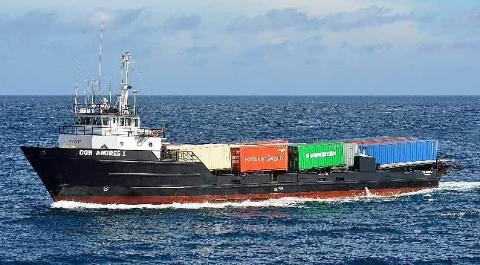
ANY TRANSPORT MODE TERMS
There are 7 Terms in this mode as Follow:
Ex-Work (EX)
Free Carrier (FCA)
Carrier Paid To (CPT)
Carriage and Insurance Paid To (CIP)
Deliver at Terminal (DAT)
Deliver at Place (DAP)
Deliver Duty Paid (DDP)

Slide 23
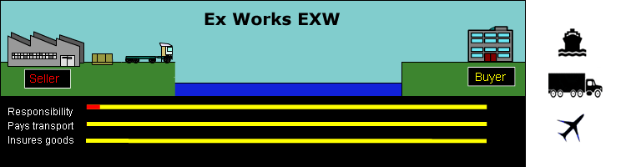
Seller Buyer
???
Seller delivers when he/she places the goods at the
disposal of buyer at the seller’s premises or another
named place (i.e. works, factory, warehouse, etc.).

Slide 24
EX-WORKS cont.
  Seller does not need to load the goods on any collecting vehicle,
  nor does it need to clear the goods for export, where such
  clearance is applicable.
  Fewest up front requirements for seller
Example: “Ex works [factory] Beer factory, Monrovia- Liberia
(Incoterms 2010)” or
2,000, 000 liters of raw rubber at $500,000.00 EXW, Firestone
warehouse, Freeport of Monrovia-Liberia

Slide 25
Free Carrier (FCA)
  Seller delivers the goods to the carrier or another person
  nominated by the buyer at the seller’s premises or another
  named place.
  The parties are well advised to specify as clearly as possible the
  point within the named place of delivery, as the risk passes to
  the buyer at that point.
  Seller does clear goods for export; import formalities are
  buyer’s responsibility
  Seller may contract for carriage at buyer’s expense and risk

Slide 26
Free Carrier (FCA) cont.
Seller’s delivery options
  If the named place is seller’s premises: seller must load goods onto
  buyer’s means of transport
  If the named place is any other place: seller must place the goods
  at buyer’s (or his carrier’s disposal) on seller’s mode of transport
  (ready for unloading)
Seller has no control over carrier, insurance, etc.
Improvements over Ex Works
  - Seller clears goods for export
  - Can be used to require seller to load goods, when seller is in a
  better position to do so

Slide 27
Carriage Paid To (CPT)
Seller delivers the goods to the carrier or another person
nominated by the seller at an agreed place (if any place is agreed
between the parties) and the seller must contract for and pay the
costs of carriage necessary to bring the goods to the named
place of destination
2 Key points
  Place of delivery of goods to carrier
    - Seller’s delivery obligation is complete
    - Risk of loss passes
  Place of destination
    - Seller contracts for and pays for carriage to the place of destination

Slide 28
Carriage Paid To (CPT) cont.
Seller clears goods for export and pays for transport
Seller pays for both loading and unloading if covered by contract
of carriage
Seller has no obligation to pay for insurance but must provide
buyer information to buy insurance at buyer’s risk and expense
Buyer obtains import licenses and carries out customs formalities

Slide 29
Carriage Paid To (CPT) cont.
  EXAMPLE
  Contract says seller is to deliver goods to shipping warehouse in
  Freeport, Terms of sale are “CPT buyer’s facility, 10 Wills Place,
  #5, Tema Port, Ghana 0387108 (Incoterms 2010).”
  Delivery obligation is fulfilled when seller delivers to the shipping
  facility in Freeport.
  Risk of loss passes at the moment the goods are handed over to
  the carrier in Freeport.
  But seller pays for carriage to Ghana

Slide 30
CARRIAGE AND INSURANCE PAID TO (CIP)
Seller delivers the goods to the carrier or another person nominated
by the seller at an agreed place; seller must contract for and pay the
costs of carriage necessary to bring the goods to the named place
of destination
Insurance requirement is minimum cover (institute cargo clause c) in
the amount of contract price plus 10% from point of delivery to
point of destination
Buyer may pay for additional coverage (institute cargo clauses a or b);
seller must provide the information necessary to allow buyer to do
so

Slide 31

Seller
Buyer
Carriage & Insurance Paid To (CIP)
Responsibility
Pays Transport
Insures goods

Slide 32
DELIVER AT TERMINAL (DAT)
  Seller delivers when the goods, once unloaded from the arriving
  means of transport, are placed at the disposal of the buyer at
  a named terminal at the named port or place of destination.
  “Terminal” includes any place, whether covered or not, such
  as a quay, warehouse, container yard or road, rail or air cargo
  terminal.
  The seller bears all risks involved in bringing the goods to and
  unloading them at the terminal at the named port or place of
  destination.

Slide 33
DELIVER AT TERMINAL (DAT) cont.
  Seller’s obligation is fulfilled and risk of loss passes at
  same time: when the goods are unloaded at the arriving
  terminal and placed at buyer’s disposal
  Can specify a point within the terminal at which time the
  obligation is complete
  Seller clears goods for export but not for import
  No requirement for insurance

Slide 34
DELIVERED AT PLACE (DAP)
  Seller delivers when the goods are placed at the disposal of the
  buyer on the arriving means of transport ready for unloading
  at the named place of destination.
  The seller bears all risks involved in bringing the goods to the
  named place.
  Goods are placed at buyer’s disposal at named location ready
  for unloading; risk passes at that point
  No obligation for insurance

Slide 35
DELIVERED AT PLACE (DAP) (cont.)
  Much like DAT, but with additional obligation by seller into
  country of delivery
  Seller clears goods for export but not import (use DDP if intent
  is to require seller to clear goods for import also).

Slide 36
Delivered Duty Paid (DDP)
  Seller delivers the goods when the goods are placed at the
  disposal of the buyer, cleared for import on the arriving means
  of transport ready for unloading at the named place of
  destination.
  The seller bears all the costs and risks involved in bringing the
  goods to the place of destination and has an obligation to
  clear the goods for export and import, to pay all duty/taxes for
  both export and import and to carry out all customs formalities.

Slide 37
Delivered Duty Paid (DDP) cont.
  Like DAP, but including seller’s obligation to clear goods for
  import—pay for any necessary licenses
  Maximum obligation for seller
  If seller is not well-suited to clear goods for import, DAP
  should be used
  No obligation to pay for insurance

Slide 38
Seller
Buyer
Delivered Duty Paid (DDP)
Responsibility
Pays Transport
???
Insures goods

Slide 39
MARITIME TRANSPORT MODE
There are 4 terms in this mode as follow:
Free Alongside Ship (FAS)
Free on Board (FOB)
Cost and Freight (CRF)
Cost, Insurance and Freight (CIF)

Slide 40
FREE ALONGSIDE SHIP (FAS)
  Seller delivers when the goods are placed alongside the vessel
  (e.g., on a quay or a barge) nominated by the buyer at the named
  port of shipment.
  The risk of loss of or damage to the goods passes when the
  goods are alongside the ship, the buyer bears all costs from the
  moment onwards.
  Seller is obligated to clear goods for export but not import
  Can be used in a string sale where seller procures goods already
  delivered for shipment

Slide 41
FREE ALONGSIDE SHIP (FAS) cont.
  Not appropriate when goods in container and delivered to carrier
  at terminal; FCA recommended.
  Seller has no obligation to pay for contracts of carriage or
  insurance but may contract for carriage and must assist buyer
  by providing necessary information for insurance
  Example:
  FAS BMC pier, Freeport, Liberia (incoterms 2010)

Slide 42
FREE ON BOARD (FOB)
  Seller delivers the goods on board the vessel nominated by the
  buyer at the named port of shipment or procures the goods
  already so delivered.
  The risk of loss of or damage to the goods passes when the
  goods are on board the vessel, and the buyer bears all costs
  from that moment onwards.
  Another change in 2010: if requested by buyer or if it is a
  commercial practice and buyer does not instruct otherwise, seller
  may contract for carriage at buyer’s risk and expense; seller may
  decline but must notify buyer promptly.

Slide 43
FREE ON BOARD (FOB) cont.
  Free on board, no longer means across the ship’s rail; now means
  on board the vessel- innovation of Incoterms 20110.
  Like FAS, but goods must be placed on board the vessel/boat
  Example:
  FOB Harper (Incoterms 2010)

Slide 44
COST AND FREIGHT (CRF)
  Seller delivers the goods on board the vessel or procures the goods
  already so delivered.
  The risk of loss of or damage to the goods passes when the goods
  are on board the vessel.
  The seller must contract for and pay the costs and freight
  necessary to bring the goods to the named port of destination
  Seller clears goods for export but not import

Slide 45
COST AND FREIGHT (CRF) cont.
2 places of importance
  Place of delivery of goods
    Seller’s delivery obligation is fulfilled when goods are on board
    the vessel
    - Risk of loss passes when the goods are on board the vessel
  Port of destination
    Seller pays for carriage to port of destination
  Seller has no obligation to obtain insurance

Slide 46
COST AND FREIGHT (CRF) cont.
Seller pays for unloading if the contract of carriage covers unloading
If intent to ship in containers and delivery is to carrier other
than vessel, use CPT
Example:
Contract says: Seller is to deliver goods on board vessel at Port of Buchanan, G/Bassa, Liberia. Terms of sale are: “CFR, Freetown (Incoterms 2010).”

Slide 47
COST AND FREIGHT (CRF) cont.
    Example:
    - Seller’s delivery obligation is fulfilled when the goods are on
    board the vessel in Buchanan; risk of loss passes then also
    - Seller must pay for shipment to Freeport
  Contract says terms of sale are: “CFR, Freeport
  (Incoterms 2010).” Silent as to port of shipment
    Seller’s delivery obligation is fulfilled when the goods are on board the vessel in the port selected by seller; risk of loss
    passes then also
    - Seller must pay for shipment to Freetown

Slide 48
COST INSURANCE AND FREIGHT (CIF)
  Seller delivers the goods on board the vessel or procures the
  goods already so delivered.
  The risk of loss of damage to the goods passes when the goods
  are on board the vessel.
  The seller must contract for and pay the costs and freight
  necessary to bring the goods to the named port of destination

Slide 49
COST INSURANCE AND FREIGHT (CIF) cont.
  Seller clears goods for export but not import
  Insurance requirement is minimum cover (institute cargo
  clause c) in the amount of contract price plus 10% from
  point of delivery to point of destination
  Like CFR but with additional obligation to procure insurance to
  port of destination

Slide 50
Seller
Buyer
Cost Insurance & Freight (CIF)
Responsibility
Pays Transport
Insures goods

Slide 51
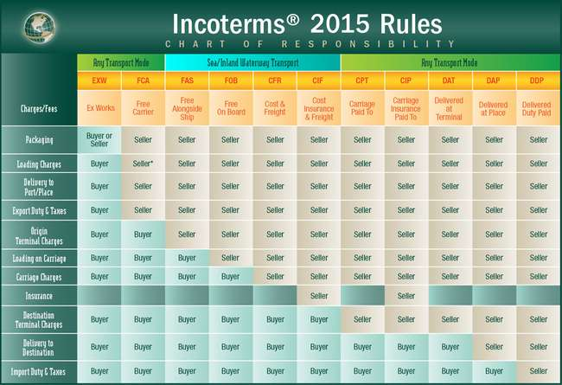
THE INCOTERMS 2015 CHART-SUMMARY

Slide 52

SESSION II
INTERNATIONAL CONTRACT OF SALE

Slide 53
SESSION OUTLINE
Introduction
Background
Session Objectives
What is international contract of sales?
Key elements of binding contract
Composition of Vienna Sales Convection (VSC)
7. Methods of payments

Slide 54
SESSION OBJECTIVES
At the end of the session, the participants will be able to:
Explain the purpose of the Contract for International Sale of Goods
Explain the key elements of contract for international sale of goods
Discuss key issues to consider in contracting
Discuss the methods of payments

Slide 55
INTRODUCTION
An International Contract of Sales is an agreement between a seller
and a buyer for the sale of goods, it should at a minimum,
identify the seller and buyer, the quantity and type of product,
delivery time, price and conditions of payment.
It references the governing body of law, the forum where any
disputes are to be resolved and the method of dispute resolution
- arbitration as opposed to litigation.
It refers to the UN Convention on Contracts for the International
Sale of Goods (CISG), also, known as Vienna Convention.

Slide 56
BACKGROUND
The United Nations Convention on Contracts for the International
sale of goods provides a uniform text of law for international sales
of goods. The convention was prepared by UN Commission on
International Trade Law (UNCITRAL) and adopted by a diplomatic
conference on 11 April 1980 in Vienna.

Slide 57
BACKGROUND cont.
Preparation of a uniform law for the international sale of goods
began in 1930 at the International Institute for the Unification
of Private Law (UNIDROIT) in Rome. After a long intervention in
work as result of the second World War, the draft was submitted to
the diplomatic conference in 1964 which adopted two conventions
one on the international law of goods and the other on the formation
of contracts for international sales of goods.

Slide 58
WHAT IS INT’L CONTRACT OF SALES?
An agreement between the seller and buyer for sales of goods.
It identifies the quantity, type of products, delivery time, price
and conditions of the goods.
It references the body of law any disputes arising from contract will
be resolved under and the method of resolution.
It should always indicates terms of sales –preferably one of
11 Incoterms.
Refers to sales between 2 parties from different countries

Slide 59
KEY ELEMENTS OF BINDING CONTRACT
Maturity of obligation or meeting of minds
Definite terms
Consideration
Capacity
Legal Purpose

Slide 60
ISSUES TO CONSIDER IN CONTRACTING
The must be an offer, offeror, offeree and an acceptance
Validity of the contract and expiry dates for shipment
and arrival.
Risk of exchange rates of fluctuations
The precise Incoterms used
Arbitration clause
The precise documents the seller must pass to buyer
A force majeure clause

Slide 61
COMPOSITION OF VSC
2 Uniform laws and 4 Parts
The 2 Uniform Laws:
Uniform law of international sales of goods (uniform
law of sales)
2. Uniform law on the formation of contracts for
international sales of goods (Uniform law of formation)

Slide 62
COMPOSITION OF VSC cont.
B. The 4 Parts:
Sphere of Application and General Provisions
( Articles 1-13).
2. Formation of Contract (Articles 14-24)
3. Sales of Goods (Articles 25-88)
4. Final Provisions (Articles 89-101)

Slide 63
METHODS OF PAYMENTS
There four (4) methods of payments for imported
goods follow:
1. Clean payment
2. Open account
3. Documentary collection
4. Documentary credit

Slide 64
SESSEION SUMMARY
Today in this session, we discussed the follow:
The CISG was signed in Vienna on 11 April 1980 during
a diplomatic convention. It is also referred to as VSC.
VSC was signed by 11 members states in 1980 and is now
signed up by 85 states as of September 2016.
CISG deals with sales contract between seller and buyer from
different states. It considers price, quantity, time, litigation, etc.
VSC comprises of the Uniform laws of sales and the
Uniform laws Formation.
,

Slide 65
SESSEION SUMMARY cont.
We also looked at contract from the aspect of Sphere of
Application and General, Formation of contract, Sales of Goods
and Final provisions.
The key elements of binding contract are Maturity of
obligations, Definite terms, Consideration, Capacity and Legal
purpose.
Finally, we discussed the four methods of payments namely:
Clean payment, open payment, documentary Collection and
Documentary Credit.

Slide 66
THANK YOU
Q &A

