Slide 1

CUSTOMS BROKERS LICENSING TRAINING PROGRAM
MODULE V:
HS Classification
Presented By: LRA TRAINING TEAM

Slide 2
INTRODUCTION
The participants in this course are entreated to do their utmost best to enhance their knowledge and skills to make them efficient and active participants and to contribute effectively to the conduct of the class session. This may lead to a successful pass in the Customs Brokers Licensing uniform examination.
2

Slide 3
INTRODUCTION
On the other hand, participants who may not assert themselves proficiently in this module, could stand the risk of not passing the uniform examination and may fail to be licensed to practice as professional Customs broker.
3

Slide 4
OUTLINE
Module objectives
Background to Tariff Classification—Evolution
Overview of the HS structure
The structure of the HS—Liberia 2012 HS vs. CET
Overview of the General Interpretative Rules (GIRS)
The meaning of classification
Why classify using HS?
How to us the HS

Slide 5

Module Objectives
At the end of this module, participants should be able to:
Define technical terms and Latin phrases used in the customs nomenclature
Outline the evolution of customs nomenclature
State the reasons for tariff classification
Identify the uses of the Harmonized System
Outline the structure of the Harmonized System
4

Slide 6
Module Objectives Cont.
At the end of this module, participants should be able to:
Compare and contrast Liberia 2012 HS Tariff Structure to that of the CET
Identify the concept/principles of HS classification
Outline the legal basis for tariff classification
Identify relevant documents required for proper classification
Correctly apply the GIRs to classify traded goods
5

Slide 7
EVOLUTION OF THE HS NOMENCLATURE
SESSION I

Slide 8
Session Objectives
At the end of this session, participants should be able to:
Out the important stage (dates) to the evolution of the HS
Define key terminologies and Latin phrases use in the HS nomenclature
Outline the goals and reasons for HS classification
Outline the uses of the HS
6

Slide 9
The Evolution of Customs Nomenclature
The Harmonized System took over 100 years to design; beginning in 1853 with the International Statistical Nomenclature (ISN) up to the Harmonized System (HS) in 1988.
ISN—1853
GN—1931
BTN—1950
CCCN—1974
HS—1988
7

Slide 10
Definition of key terms and Latin phrases
International trade is an exchange of goods between two or more countries.
CET means common external tariff.
Mutatis mutandis means with the necessary changes
Inter alia means among other things
Prima facie means at first sight
Etc. =etcetera means and the others/and so forth
10

Slide 11
Definition of key terms and Latin phrases Cont.
Nomenclature means a systematic naming, or enumerating of all goods found in international trade along with international rules and interpretations.
Customs tariff as used herein refers to a systematic classification of goods entering the international trade for national interests together with rates of duties.
Classification means a process of arriving at a particular heading or subheading of a commodity entering the international trade.
9

Slide 12
Overview of the HS
Core specifics and structure of HS is universal
Member countries eligible to define specific detail items and assign applicable rates of duty to any required category
Goals:
Systematic classification of all goods
Uniformity in classification
Internationally accepted customs language
9

Slide 13
Reasons for Tariff Classification
Systematic Classification of all goods
Uniform Classification of all goods
To have common Customs language
To ensure simplification and certainty
9

Slide 14
Uses of Harmonized System
Basis for customs tariff
Collection of international trade statistics
Rules of origin
Collection of government revenue
Trade negotiations (e.g. the WTO schedule of tariff concessions)
Transport tariffs and statistics
Monitoring prohibited and restricted goods
11

Slide 15
SESSION II
HS STRUCTURE

Slide 16
Session Objectives
At the end of this session, participants will be able to provide information regarding:
Structure of the HS Nomenclature
Compare and contrast HS and CET Structures
Distinguish b/w legal and non-legal text of the HS
Outline basic principles underlying HS structure
12

Slide 17
The Structure of the HS
A six-digit nomenclature
First four digits equal heading
First six digits equal sub-heading

Slide 18
HS Structure—LIB 2012 HS vs. CET
Liberia 2012 HS
Rate (Advalorem) | Frequency
0% | 2
1.5% | 9
2.5% | 473
5% | 1930
7.5% | 870
10% | 440
11% | 99
15% | 989
20% | 607
25% | 311
45% | 1
50% | 57
CET
Rate | Description
0% | Essential goods
5% | Basic raw materials, capital goods and specific inputs
10% | Intermediate goods
20% | Finished goods (ready for consumption)
35% | Selected finished industrial products with regional capacity or potentials

Slide 19
HS STRUCTURE CONT
21 Sections
99 Chapters
1258 Headings
5387 Subheadings

Slide 20
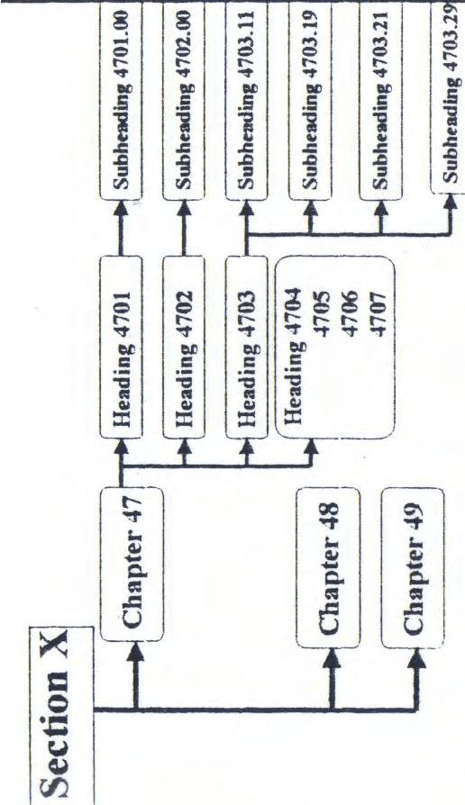
The HS Structure
Diagrammatic Illustration

Slide 21
HS Structure Cont.
International—(HS) Code Positions
Chapter 1 & 2
Heading 3 & 4
Subheading 5 & 6

Slide 22
Basic Principles of the HS Structure
Level of processing of the goods
Origin of the goods
Chemical composition of the goods
Material make-up of the goods
Functions of the goods

Slide 23
Text of the HS
Legal Non-Legal
GIRs index
Section Notes Section Titles
Chapter Notes Chapter Titles
Subheading Notes Subchapter Titles
Heading Explanatory Notes
Subheading Compendium of classification opinion

Slide 24
SESSION III
OVERVIEW AND APPLICATION OF THE GIRS

Slide 25
Session Objectives
At the end of this session, participants will be able to:
provide information on General Interpretative Rules (GIRS)
Outline the principles of tariff classification
List the steps to using the HS
Correctly apply the GIRs to classify goods

Slide 26
Principles of tariff classification
A commodity can be classified either by:
Terms of heading
Notes to sections, chapters or subheadings
General Interpretative Rules

Slide 27
General Observation
Goods in the HS are grouped in two broad categories:
Goods which the earth is endowed with.
E.g. minerals, animals, plant water, etc.
Goods which are man-made
e.g. TVs, motor vehicles, the list is endless because of change in technologies

Slide 28
General Observation Cont.
Goods under chapters 1 to 83 are generally classified according to material of manufacture
Under chapter 84 to 96 are generally classified to function

Slide 29
Overview of GIRs
GIRs are designed to ensure that a given product is always classified in the same heading and subheading with the exclusion of any other heading meriting consideration. In fact, they illustrate and provide step-by-step basis for classification of goods in the harmonized system.

Slide 30
Summary of GIRs
Six Rules
Must be applied in numerical order esp. GIRS (1-4)
Rules 1-4 classify actual goods
Rule 5; packing and packaging
Rule 6; classify at 6 digit sub-heading level

Slide 31
Usage of GIRs
Use terms of the headings
Use terms of the section and chapters notes
NOTE: Most goods are classified to their direct heading without recourse to rules 2-4

Slide 32
How do we use the HS
Read explanatory notes
Refer to index
Find headings that appear to describe the goods
Find the most specific headings
Check section and chapter notes
Apply GIRS

Slide 33
Important Qs
Before classification:
What is it?
What material or substance is it made of?
What are its function or use?
In what form is it usually imported?
Is this the only possible classification?

Slide 34
Example of Classification
Laptop Computer
Identity: machine
material: various (above Chap. 83)
Function: Data processing
Possible section: XVI
Possible Chap. 84
Heading 84.74

Slide 35
Example of classification Cont.
FORK OF WOOD
Identity: Article of wood
Material: wood (below Chap. 83)
Function: Tableware/cutlery
Possible Section: IX
Possible Chap. 44
Heading 44.19

Slide 36
Self-Testing Questions
Classify the following articles:
Chair made of wood
Radio
umbrella
Playing cards
Plastic toys

Slide 37
Self-Testing Questions
Classify the following articles:
Chair made of plastic
flour
Biscuit
Silk & cotton men shirt
Plastic toys
Alum. Zinc
Eye glasses

Slide 38
THANK YOU

