Slide 1

CUSTOMS BROKERS LICENSING TRAINING PROGRAM
MODULE VI:
ASYCUDA
Presented By: LRA TRAINING TEAM

Slide 2
MODULE OBJECTIVE
At the end of this module, the participants will be able to:
Discuss the brief history of ASYCUDAWorld
Explain the process of logging on to ASYCUDA
Identify the SAD fields
Identify the regimes used in ASYCUDA
Types of Declaration
Demonstrate how to complete declaration cycle in ASYCUDA
Find and view declarations in ASYCUDA
Approval of Warehouses
Explain the transit procedures

Slide 3
BRIEF HISTORY OF ASYCUDA’S OPERATIONS IN LIBERIA
The government of Liberia believes that among many, the modernization of the commercial elements of foreign trade to meet international standard is very crucial to the development of the country.
In April 2009 the government of Liberia signed an agreement with the African Development Bank (ADB) with the United Nations Conference on trade and development ( UNCTAD ) to introduce the well accomplished customs computer system in the world, ASYCUDA ( Automated System for customs Data )

Slide 4
CONT’
The signing of the agreement was closely followed by the official launch of the ASYCUDA World (AW) project on 1st July, 2009 by the Deputy Minister of Finance for Revenue, Mrs. Elfrieda Stewart Tamba.
On the targeted aforementioned date, November 2, 2009, the country took a “move forward step” in this direction, when the Bureau of customs at the Ministry of Finance officially lunched the use of ASYCUDA World at the Freeport of Monrovia.

Slide 5
Accessing ASYCUDA World
Since ASYCUDA World is a web‐enabled computer system, the system in Liberia has been built onto web page. The ASYCUDA World website provides a link to login; . In Liberia, ASYCUDA world live IP is: http://192.168.1.5:8081/awclient/

Slide 6
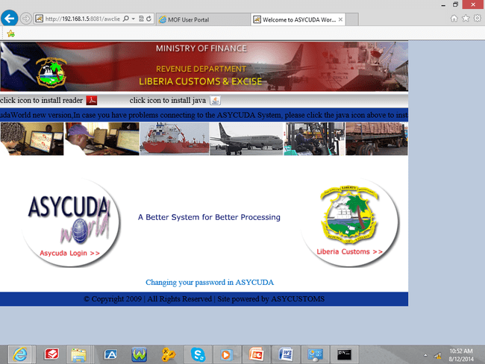
ASYCUDA WORLD web page
Acrobat Reader setup Icon
Java setup Icon
Lunch ASYCUDA from here

Slide 7
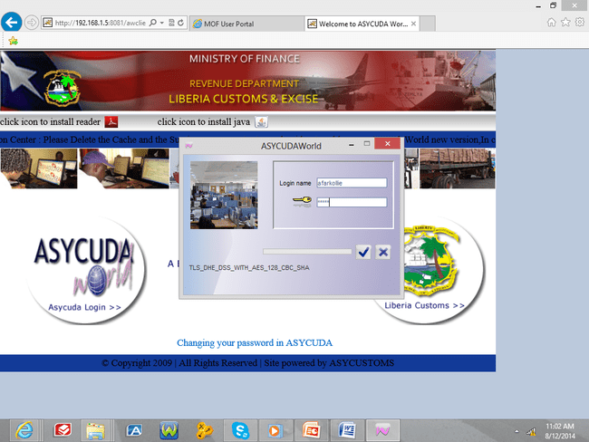
Login Portal
The website provides an ASYCUDA World Login Link and user may access the link with the appropriate login credential.

Slide 8
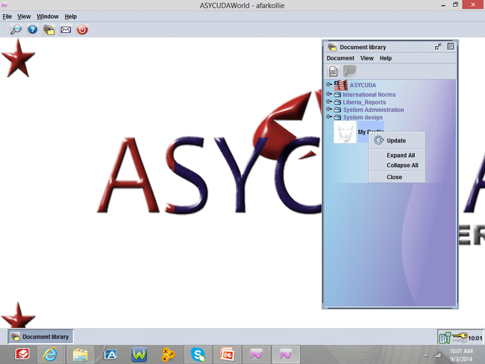
CHANGE OF PASSWORD
Steps to change Password
Click Behind ASYCUDA
Right click My Profile
And update will be displayed as seen below. Right click to update.

Slide 9
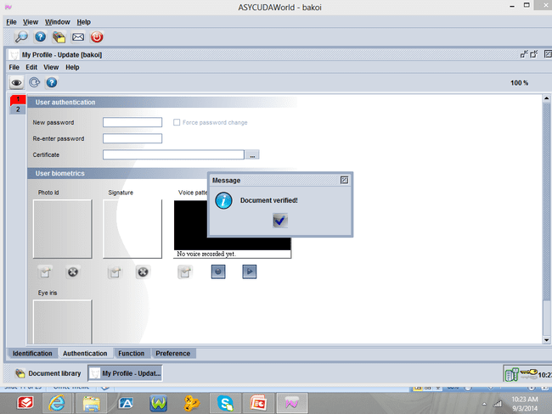
CONT’
Go to authentication and the following information will appear such as;
Enter New Password
Re- Enter new password
Verified to the Eye icon and Validate to Update Icon as seen below:

Slide 10
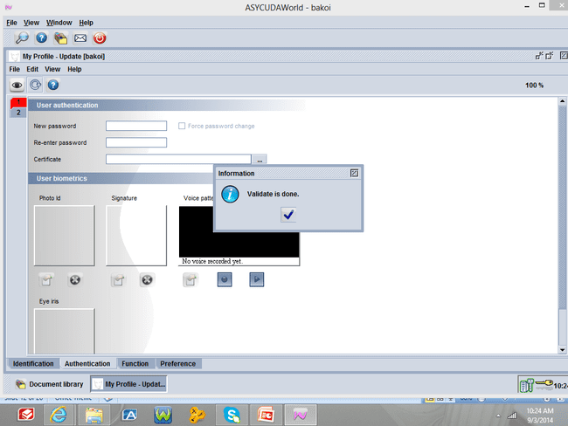
CONT’
When you Validate by clicking to the Update Icon, a small window will appear
Requesting for old password, Enter the old password, verified and validate.

Slide 11
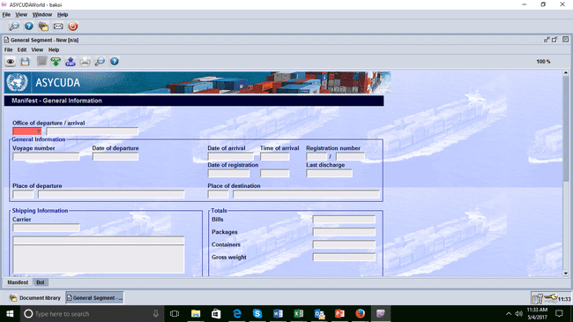
MANIFEST

Slide 12
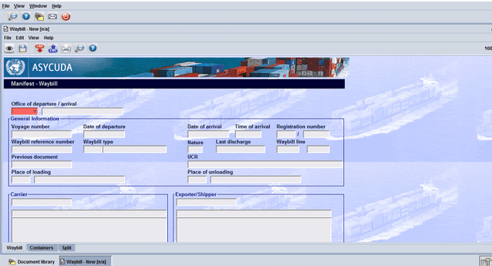
WAYBILL

Slide 13
TYPES OF DECLARATION
TYPE | TYPE OF DECLARATIONS
 | EXPORTATION
EX 1 | Exportation
COM 1 | Exportation within the community
Ex 2 | Temporary Exportation
COM 2 | Temporary Exportation within the community
Ex 3 | Re-Export
COM 3 | RE-Exportation within the community
 | IMPORTATION

Slide 14
CONT’
TYPE | TYPE OF DECLARATIONS
 | IMPORTATION
IM 4 | Entry for Home Use Consumption-Destination Inspection
COM 4 | Entry for home use Consumption within the commu nity-Destination Inspection
PSI 4 | Entry for Pre-shipment inspection-outside ECOWAS Community
PSC 4 | Entry for Pre-shipment inspection from ECOWAS Community
SDI 4 | Simplified Declaration for Goods from outside ECOWAS Community
SDC 4 | Simplified Declaration for Goods from ECOWAS Community
SRI 4 | Special Release for Goods from Outside ECOWAS Community
SRC 4 | Special Release for Goods From ECOWAS Community

Slide 15
CONT’
TEMPORARY IMPORTATION
IM 5 | Temporary Importation for Goods from Outside ECOWAS Community
COM 5 | Temporary Importation for Goods from ECOWAS Community
RE-IMPORTATION
IM 6 | Re-Importation, Destination Inspection, Goods from outside ECOWAS
COM 6 | Re-Importation within the community-Destination Inspection
WAREHOUSING
IM 7 | Entry for warehousing for goods from Outside ECOWAS Community
PSI 7 | Entry for Warehousing, pre-shipment inspection-from Outside ECOWAS Community

Slide 16
TRADE REGIMES
Understanding trade regimes is important for a variety of reasons. For example for accurate data analysis, a user should first understand trade regimes. Other reasons are given below;
Understand the different versions of the Singe(single) administrative Document (SAD) and their applications
Analysis data for trade statistics such as volume of trade with ECOWAS
Understand why some declarations pay tax and others do not.
Distinguish between imports and exports
Distinguish between DI and PSI declarations for policy formulation or data analysis
Audit the system or taxpayers

Slide 17
Section 14151 of the Revenue code of Liberia act of 2000 gives credence to the use of regimes in ASYCUDA by defining the various regimes as follows:
Imported goods may be entered:
a) For consumption; or
b) For warehousing; or
c) For transit or transhipment; or
d) Where permitted under the Customs laws, for the temporary importation with a view to their re-exportation;

Slide 18
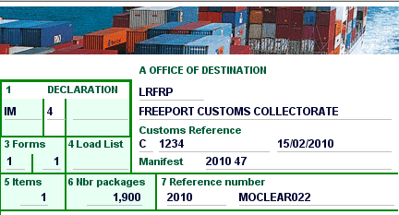
SAD Form

Slide 19
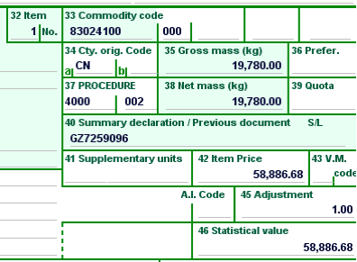
CONT’ OF SAD FORM

Slide 20
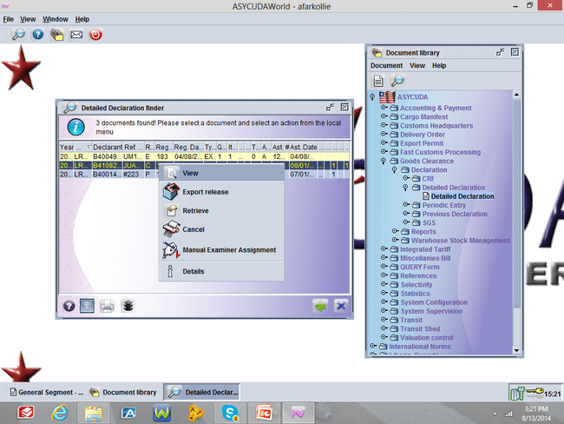
FIND AND VIEW A DECLARATION

Slide 21
Section 14185. Approval of Warehouses
(a) The Minister may, upon application of the occupier thereof, approve, for such periods and subject to such conditions and restrictions as he sees fit to impose, places of security for the deposit of
(1) Any goods chargeable with a duty of customs, without payment of that duty; (2) Imported goods intended for re-exportation or shipment as stores, being goods not eligible for consumption in Liberia; and
(3) Goods permitted under the customs laws to be warehoused on payment of drawback. (b) Any place of security so approved shall in this Code be referred to as a “warehouse”.
(c) The Minister may in his approval specify –
(1) The class or description of goods which may be deposited in any particular warehouse;and

Slide 22
CONT’
(2) The part of any warehouse in which any class or description of goods may be deposited.
(d) The Minister may at any time, for reasonable cause, revoke or vary the terms of approval of a warehouse.
(e) The warehouse proprietor shall not, without the previous consent of the Minister, make any
addition or alteration of the warehouse.
(f) If any person contravenes or fails to comply with the provisions of any approval granted by the Minister he shall be liable to a penalty of $200,000.00 and any goods in respect of which the
offence is committed shall be liable to forfeiture.

Slide 23
Section 14195. Withdrawal of Goods from Warehouse
(a) Entry Required. Before any goods are withdrawn from warehouse an entry therefor must be
delivered to the proper officer in such form and manner and containing such particulars as the
Minister shall prescribe.
(b) Purpose for Which Goods May be Withdrawn. Goods may be withdrawn from warehouse for
(1) consumption; or
(2) exportation or shipment as stores without payment of duty; or
(3) removal to another warehouse without payment of duty; or
(4) any other purpose approved by the Minister.
(c) Payment of Duty.

Slide 24
CONT’
Except as permitted by or under any provision of this Code or other enactment, no goods shall be withdrawn from warehouse until any duty chargeable thereon has been paid and any duty shall be paid at the time when the entry is delivered.
(d) Person Who May Make Entry. No goods may be entered for withdrawal from warehouse other than by the person shown as the importer or owner thereof on the entry of goods for first warehousing or re-warehousing, as the case may be, or any person to whom such importer or
owner has transferred the right to withdraw the goods in accordance with the provisions contained in regulations made by the Minister.

Slide 25
CONT’
(e) Goods to be Withdrawn in Complete Packages. Except as otherwise allowed by the Minister,
goods shall be withdrawn from warehouse only in the complete packages or lots in which they were entered for warehousing.
(f) Warehouse Proprietor to Authorize Withdrawal. No entry shall be valid for the withdrawal of
goods from a warehouse until the proprietor thereof has certified his authority for the withdrawal on the entry therefor.
(g) Officer’s Permission Required. Notwithstanding any other provisions of this Section, no goods may be withdrawn from warehouse except with the permission of, and in accordance with any directions given by, the proper officer.

Slide 26
Section 1424. Goods Reported for Transshipment or Removal in Transit to a Place outside Liberia
Where, in the case of goods imported by sea and reported for transshipment or transit to a place outside Liberia, the goods have not been unloaded from the importing vessel, or have not been entered for such transshipment or transit, or have not been produced for examination by an officer within thirty-five days of the date when report was made of the importing vessel or, where no such report was made the date when it should properly have been made, the proper officer may cause the goods to be removed to a Government warehouse at the expense and risk of the master, or owner of the vessel or his agent in Liberia to await entry or other proper disposal.

Slide 27


